Slide 1
EXPRESS OVERVIEW & INSTALLATION EXPRESS
-Bhupesh Ther (NSTI MUMBAI)

Slide 2

Agenda
Introduction Of Express Js
What is Express js
Who Developed And History
Installation And Dependencies
Routing In Express Js
Error Handling
Free Templates Engines
Restful api
Testing And Debugging

Slide 3
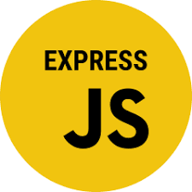
Introduction
This presentation provides an overview of Express.js, including installation, implementation express js. We will explore the key concepts and benefits of using Express.js for web development.

Slide 4

What is Express.Js?
Express.js is a minimalist web application framework for Node.js, designed for building web applications and APIs. It provides a robust set of features for web and mobile applications, making it a popular choice among developers.

Slide 5
Who Developed Express Js ?
Express, was developed by TJ Holoway chuk and is now maintained by the Node.js Foundation. TJ Holoway chuk initially released Express.js in 2010.The stable version of Express.js is 4.18.1, released in April 2022.

Slide 6
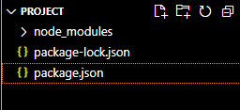
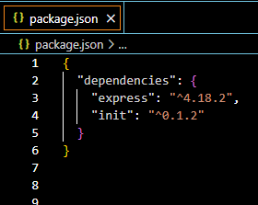
Installation
Installing Express.js is simple using Node Package Manager (npm). By running the command npm install express, you can quickly add Express.js to your project and start building powerful web applications.
Installing Commands
$ npm init
$ npm install express
$ npm install express --no-save

Slide 7
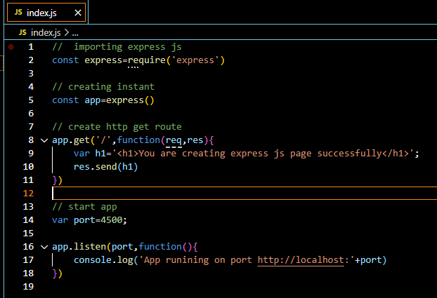

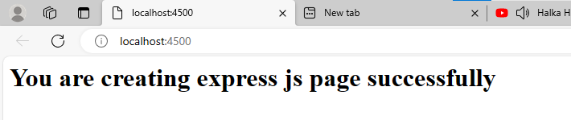
ROUTING IN EXPRESS.JS
Express.js provides a simple and elegant way to define request handling using routing. By mapping HTTP methods and URLs to functions, developers can create efficient and organized application logic.

Slide 8
Error Handling
res.
try...catch
err.message
err.status
res.status(statusCode)
res.send(message)
In Express.js, error handling is crucial for maintaining robust applications. By using middleware functions specifically for error handling, developers can ensure graceful and secure error management.

Slide 9

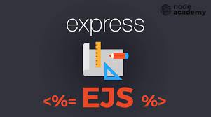


Templating Engines
Express.js supports various templating engines such as Pug, EJS, and Handlebars.
These engines enable developers to create dynamic and reusable HTML content for web applications.

Slide 10
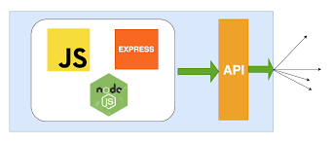

Restful Apis With Express.Js
Express.js is ideal for building RESTful APIs, providing a ﬂexible and powerful
framework for creating and managing API endpoints. It simplifies the process of handling HTTP requests and responses.

Slide 11



Testing And Debugging
Effective testing and debugging are essential in Express.js development.
Utilizing tools like Mocha, Chai, and debug, developers can ensure the reliability and stability of their applications.

Slide 12

Why We Used Express Js ?
Build web applications swiftly and efficiently while offering a strong foundation for creating RESTful APIs and managing middleware effectively.
Its robust routing system and extensive middleware support streamline development, while its active community provides ample resources for efficient coding
Advantages:
Simplicity and Ease of Use
Flexibility and Customization
Routing and Middleware
Performance
Large Community and Ecosystem
Disadvantages:
Steep Learning Curve (beginner)
Opinionated Design
Potential for Code Complexity

Slide 13

Thanks You
Do you have any questions?

